Slide 1
Canonical and Standard Forms
CSE 4205: Digital Logic Design
Aashnan Rahman
Junior Lecturer
Department of Computer Science and Engineering (CSE)
Islamic University of Technology

Slide 2
01
Minterms and Maxterms
ANDed or ORed Terms

Slide 3

Minterms
A product (ANDed term) that contains all the variables of a particular function in either in original form or complemented form.
Also known as Standard Product.
n variables can be combined using AND to form 2^{n} minterms.
Symbol →
1 priority
0 → complemented form
2) 1 → original form

Slide 4
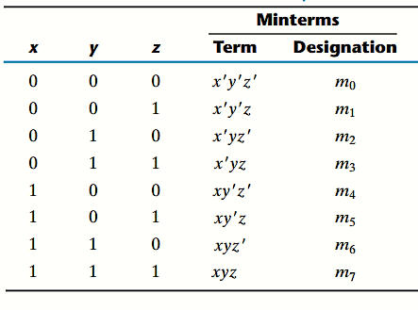
Minterms

Slide 5

Maxterms
A sum (ORed term) that contains all the variables of a particular function in either in original form or complemented form.
Also known as Standard Sum.
n variables can be combined using OR to form 2^{n} Maxterms.
Symbol →
0 priority
1 → complemented form
2) 0 → original form

Slide 6

Maxterms
Maxterm and its corresponding Minterm are complements to each other.

Slide 7
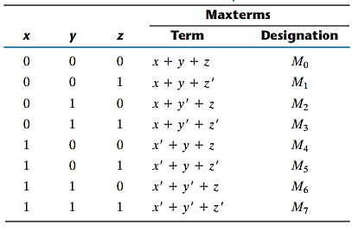
Maxterms

Slide 8
Boolean Functions using Minterms (SoP)
Any boolean function can be expressed as a sum of minterms (or product of maxterms).
From a given truth table, minterms are produced from those combinations of variables which produces 1 (True) .
The required function is the AND or sum of the minterms having output 1.

Slide 9
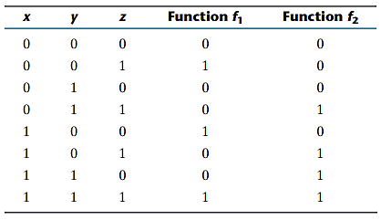
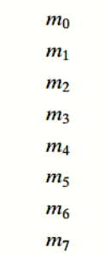





Boolean Functions using Minterms (SoP)

Slide 10



Boolean Functions using Minterms (SoP)

Slide 11
Boolean Functions using Maxterms (PoS)
Any boolean function can be expressed as a product of maxterms (or sum of minterms).
From a given truth table, maxterms are produced from those combinations of variables which produces 0 (False) .
The required function is the OR or product of the maxterms having output 0.

Slide 12








Boolean Functions using Minterms (SoP)

Slide 13





Boolean Functions using Minterms (SoP)

Slide 14
Complement of Boolean Functions
Taking each combination of variables (minterms) that produces 0 (False) in the function and OR them.
Or, taking each combination of variables (maxterms) that produces 1 (True) in the function and AND them.

Slide 15
02
Standard and Canonical Form
SoP and Pos Forms

Slide 16
Canonical Form
A Boolean expression is in canonical form when each term in the expression contains all the variables in the domain (either complemented or not).
There exists two such forms
Sum of minterms / Products (SoP)
Product of maxterms / Sums (PoS)

Slide 17


Sum of Minterms
If the function is not in this form,
The expression is expanded into a sum of ANDed terms.
Each term is inspected whether it contains all the variables, if missing it is introduced by ANDing the term with (x + x’).
Notation 1
Notation 2

Slide 18
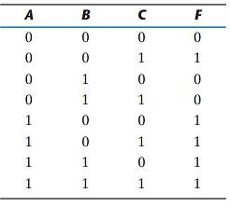

Sum of Minterms

Slide 19



Product of Maxterms
If the function is not in this form,
The expression is expressed into a product of ORed terms.
Each term is inspected whether it contains all the variables, if missing it is introduced by ORing the term with (x.x’).
Notation 1
Notation 2

Slide 20


Conversion between Canonical Forms

Slide 21
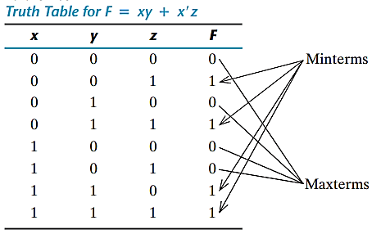


Conversion between Canonical Forms

Slide 22
Standard Form
Canonical forms:
  Both are easily formed from truth table
  Each minterm or maxterm must contain all variables; either primed or unprimed
Standard form:
  Terms may have one, two, three or any number of literals.
  Two types: SOP and POS

Slide 23

Standard Form (SoP)
Has ANDed terms (products) which are finally ORed (sum)
Logic diagrams contain a group of AND gates followed by a single OR gate. It’s assumed that the complements of variables are directly available in their input. Known as two-level-implementation
SOP:

Slide 24

Standard Form (PoS)
Has ORed terms (sums) which are finally ANDed (product)
Logic diagrams contain a group of OR gates followed by a single AND gate. It’s assumed that the complements of variables are directly available in their input. Another two-level-implementation
POS:

Slide 25
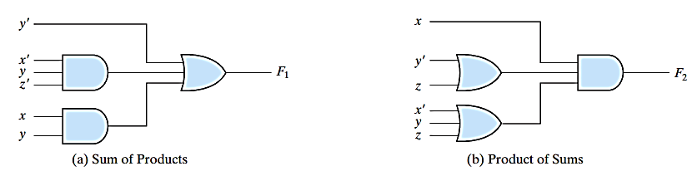
SoP and PoS
Two level implementation

Slide 26

Non -Standard Form
The boolean expression is neither in SoP or PoS form.
Nonstandard Form:
Standard Form:
Can be converted to standard form following the distributive law.

Slide 27
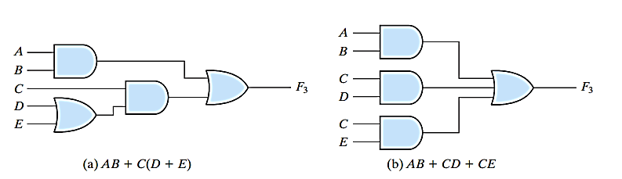
Non -Standard Form

Slide 28
Worksheets
Worksheet 1

Slide 29
Thank You !!
Feel free to ask any questions

